Slide 1

Real-Time Micro-Climate Solar Telemetry & AI Forecasting System
REVIEW 1 — WEEK 5 PROGRESS
An end-to-end telemetry and deep learning platform built by a three-person engineering team, streaming live micro-climate data, predicting solar wattage output via LSTM, and surfacing automated thermal stress alerts through a live React dashboard.
Project Team & Roles
Tech Stack
Mohammed Faiz CK
Aryan Sovit
Frontend
Backend
Full-Stack Developer & System Integrator
AI/ML & Data Pipelines
React.js
Express.js / Node.js
Database
AI / ML
Yashwanth Chandawat
MongoDB
Python — TensorFlow / Keras
Data Analytics & Testing
Data Source
Open-Meteo API

Slide 2
The Problem: Solar Output Volatility
Why Existing Systems Fall Short
Our Solution
An end-to-end IoT Telemetry platform streaming live weather metrics, predicting wattage output via deep learning (LSTM), and triggering real-time thermal alerts.
Rapid Micro-Climate Fluctuation
Solar output fluctuates rapidly due to localised micro-climates and sudden temperature spikes that coarse regional models fail to capture.
Key Value Proposition: Proactive solar forecasting combined with automated thermal stress detection — shifting operators from reactive damage control to predictive performance management.
Reactive Monitoring Paradigm
Traditional monitoring systems are inherently reactive — they report degradation after it occurs, missing sudden irradiance drops entirely.
Live
Predict
Real-time telemetry streaming
LSTM wattage forecasting
No Thermal Stress Visibility
Operators lack real-time visibility into thermal stress and performance degradation, leaving panels exposed to derating risk without automated alerts.
Alert
Automated thermal advisories

Slide 3

Development Timeline & Key Milestones
WEEKS 1 – 5
Week 1
1
Foundation
Requirements gathering, tech stack finalization, MongoDB schema design and environment configuration.
2
Week 2
Telemetry Pipeline
Ingestion script mock_telemetry.py built; Open-Meteo API weather integration operational.
Week 3
3
Deep Learning Model
LSTM Sequence Model architecture defined for 60-step solar wattage prediction. Training pipeline established.
4
Week 4
Backend & APIs
Node.js/Express child-process execution links Python TensorFlow scripts directly to REST endpoints /recent and /predict.
Week 5 ✦
5
Full-Stack UI
Live Recharts visualization, Thermal Advisory Banners, and Anomaly Injection Testing all integrated and operational.
Week 5 marks the first fully integrated end-to-end system run — from sensor ingestion through LSTM inference to live dashboard rendering.

Slide 4

System Architecture: 5-Step Data Pipeline
Ingestion
Processing
Storage
1
2
Ingestion
Storage
mock_telemetry.py fetches local weather data via Open-Meteo API
MongoDB stores time-series telemetry streams with indexed timestamps
1
2
3
AI Processing
UI Presentation
predict.py passes a 60-step sequence to the LSTM neural network for wattage inference
React dashboard auto-polls every 5 seconds for continuous Recharts updates
Backend Engine
Node.js/Express server spawns Python child processes for model execution

Slide 5

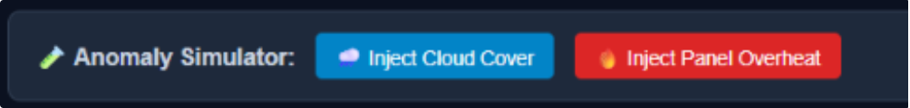

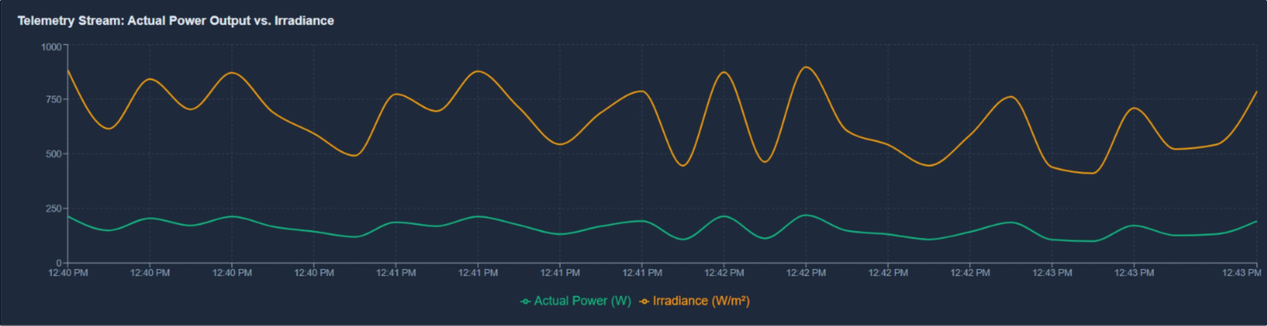
Live Dashboard Overview
WEEK 5 — UI INTEGRATION COMPLETE
Interactive Telemetry Charts
Live Weather Barometer
Animated cubic line charts powered by Recharts display Irradiance vs. Predicted Wattage in real time, auto-refreshing every 5 seconds without page reload.
Real-time outdoor temperature feed continuously synced with the Open-Meteo API, surfacing ambient conditions relevant to panel efficiency and thermal thresholds.
Quick Audit Export
System Status
Single-click CSV export button for client-side reporting and offline data auditing — no backend request required for export generation.
Live system indicator confirms the dashboard is connected and updating normally.
Dashboard Features in Action

Slide 6

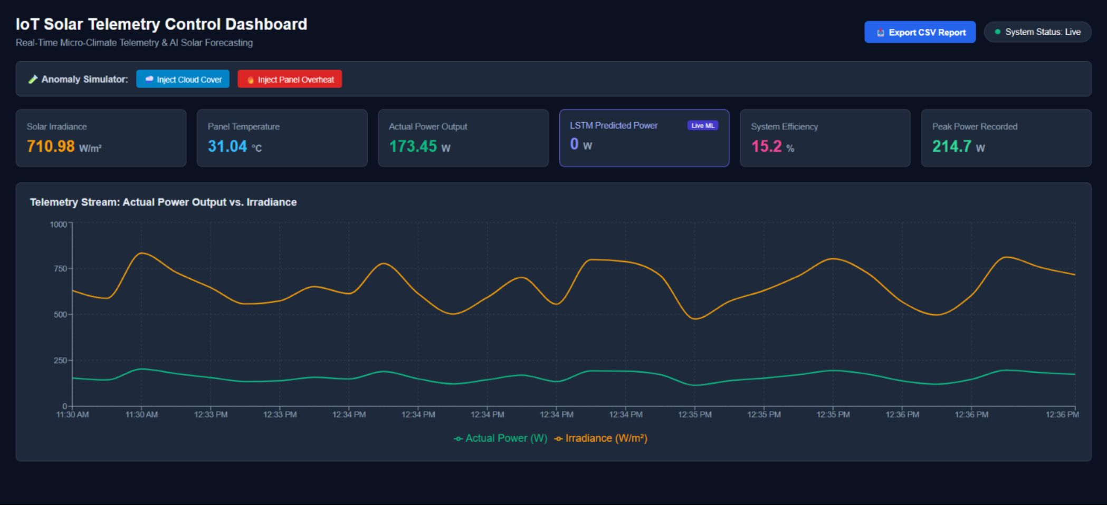
Anomaly Simulator & System Stress Testing
ENDPOINT: /INJECT-ANOMALY
The anomaly injection framework validates model responsiveness and UI alerting under synthetic but physically realistic stress conditions — confirming that the LSTM and advisory system behave correctly before hardware integration.
☁ Cloud Cover Simulation
🌡 Panel Overheat Simulation
Injection: Severe irradiance drop to 120 W/m² triggered via /inject-anomaly
Outcome: Confirms LSTM model immediately revises wattage forecast downward in response to the synthetic irradiance collapse — validating real-time model sensitivity.
Injection: Synthetic temperature spikes above 40°C pushed into the telemetry stream.
Outcome: Triggers automated UI Advisory Banner warning operators of panel derating and thermal stress — confirming end-to-end alert pipeline integrity.
Advisory banners are suppressed in demo mode. Enable live alerting before field deployment.

Slide 7
Backend & Machine Learning Deliverables
Integration Architecture
REST API Suite
Node.js Child Process Execution
/recent
/predict
Cross-runtime integration bridging the Express backend directly to Python TensorFlow — without microservice overhead. The server spawns predict.py as a child process, passing telemetry context via stdin and capturing inference output via stdout.
Fetch recent sensor logs from MongoDB time-series store. Used by dashboard on every 5-second poll cycle.
Execute LSTM inference via Python child process. Returns forecasted wattage for the next sequence window.
Preprocessing & Normalization
/inject-anomaly
Feature scaling pipeline for irradiance, ambient temperature, and power metrics. All inputs are normalized before being assembled into the 60-step LSTM sequence window.
Trigger real-world stress scenarios — cloud cover drops or overheat spikes — to validate model and UI advisory response.
60
5s
LSTM Sequence Steps
Poll Interval
Input window length for each wattage prediction
React dashboard auto-refresh rate
3
40°C
REST Endpoints
Thermal Threshold
Core API surface powering the full platform
Temperature level triggering advisory banner

Slide 8



Future Roadmap & Next Steps
Phase 3 — Cloud Production
Cloud-hosted production deployment and multi-site solar farm management at scale.
Phase 2 — Hardware Integration
Replace synthetic telemetry with real ESP32 & INA219 current/voltage sensors for genuine field data ingestion.
Phase 1 — Mobile Deployment
Deploy via Capacitor / Android Gradle toolchain, enabling field technicians to monitor telemetry and receive thermal alerts on mobile devices.
Where We Are Today
Open for Questions & Live Demonstration
End-to-end system fully integrated through Week 5 — ingestion, LSTM inference, REST API, and live React dashboard all operational with anomaly testing validated.
The system is running live. The team is ready to walk through the dashboard, trigger anomaly injection via /inject-anomaly, and demonstrate LSTM inference in real time.
MOHAMMED FAIZ CK
ARYAN SOVIT
YASHWANTH CHANDAWAT

